Slide 1
SMART WIND-MILL ENERGY PREDICTION SYSTEM
Team Name- THE LEADERS
Team Leader- Ravi
Project Id- SPS_PRO_666

Slide 2
Content
Introduction
Problem Statement
Project Objective
Methodology
Result
Advantages and Disadvantages
Application

Slide 3
Introduction
In today's world, as a developing country, India must shift its energy harnessing resources from non-renewable to the renewable resources. Today the non- renewable energy resource which is used for electricity generation is coal, about 59.9 %.
Coal is burned to get heat energy, which is later converted to steam pressure, which runs the turbines. But the main drawback of this method is, firstly the coal resource is limited, and secondly, burning of coal produces large amount of greenhouse gases.
If we use non-renewable sources of energy, like wind energy, it is difficult to predict the accurate output at given time in future. This makes difficult to decide when to use these resources and when not.

Slide 4
Problem Statement
In today's world, as a developing country, India must shift its energy harnessing resources from non-renewable to the renewable resources.
So, we must shift to renewable or green energy resources. And one of the renewable source of energy which we will use in this project is wind energy. But due to lack of proper prediction of energy output at given time in future, it is difficult to use properly.
So, in this project I have built a web application based on Node-red and cloudant, to predict accurately the output energy of a wind park, for next 48 hours. It also shows the detail view of power output with respect to every hour for next 48 hours time. There is also an option to record this data, if user wants to.

Slide 5
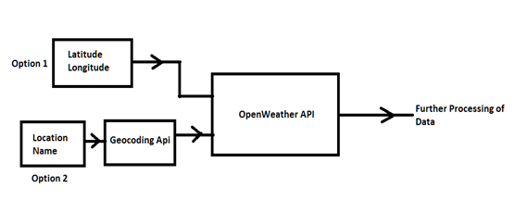
Methodology
To predict the power output for a place, first we need to give the location name, this can be done in two ways-
by directly entering the latitude and longitude of the location,
or by entering the city or location name.
I will use Open Cage geocoding API to convert location name to the corresponding latitude and longitude. And then we use openweather API to fetch weather details for that coordinates of next 48 hours. OpenWeather API will gets input in Coordinates format.

Slide 6
Methodology
Power Generation of wind mill depends on the following factor-
Air Density at that location
Wind velocity at that location
swept Area of wind mill
Power Coefficient factor.
No. of wind mills.
In the above factors, Air density at a location is the function of-
Atmospheric pressure
Humidity
Absolute Temperature

Slide 7
Methodology
Air Density can be calculated as follow-
Calculate the saturation vapor pressure at given temperature T using the formula-
p₁ = 6.1078 * 10^[7.5*T /(T + 237.3)], where Ts is measured in degree Celsius.
Saturation vapor pressure is the vapor pressure at 100% relative humidity.
Find the actual vapor pressure, multiplying the saturation vapor pressure by the relative humidity:
pv = p₁ * RH.
Subtract the vapor pressure from the total air pressure to find the pressure of dry air:
pd = p - pv.
Input the calculated values into the following formula:
ρ = (pd / (Rd * T)) + (pv / (Rv * T))
where:
pd is the pressure of dry air in Pa, pv is the water vapor pressure in Pa,
T is the air temperature in Kelvins, Rd is the specific gas constant for dry air equal to 287.058 J/(kg·K),
Rv is the specific gas constant for water vapor equal to 461.495 J/(kg·K).

Slide 8
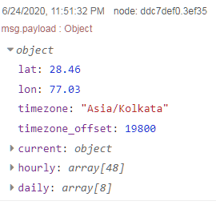
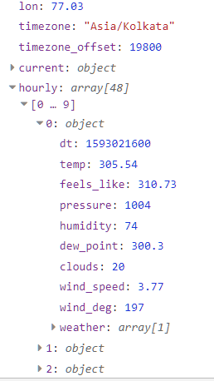
Methodology
All these values are present in the data fetched from openWeather API

Slide 9
Methodology
Power Calculation-
Now after calculating the air density, we can calculate the power as follow-
Power = n * Cd * 0.5 * ρ * A * v^3
where,
Cd is the power coefficient factor.
ρ is the Air Density.
A is the swept Area of Wind Mill.
v is the Air Velocity.
n is no. of wind mills.
Swept Area is Calculated from-
= Pi* r²
Where r is the blade length of wind mill, given by the user.

Slide 10
Methodology
As explained, Air density and power output model is calculated for every next hour value present in the data fetched from the openWeather API. So, this will give accurate results for the next 48 hour power output. To give the maximum total power, all the values in the power model are summed together to give total power output value.
Along with the power output, Some extra data is also shown, which contain the amount of coal saved, by using wind energy and amount of CO₂ emission reduced by using wind energy. This will be calculated as follow-
Approximately 400 Kg of coal is used to generate 1 MW of power. And multiplying total power in MW by 400 gives the coal consumption in Kg.
And Approximately 940 Kg of CO₂ is released in environment in generating 1 MW of Electricity using coal. By multiplying total power in MW by 940 we will get total CO₂ saved in Kg.

Slide 11
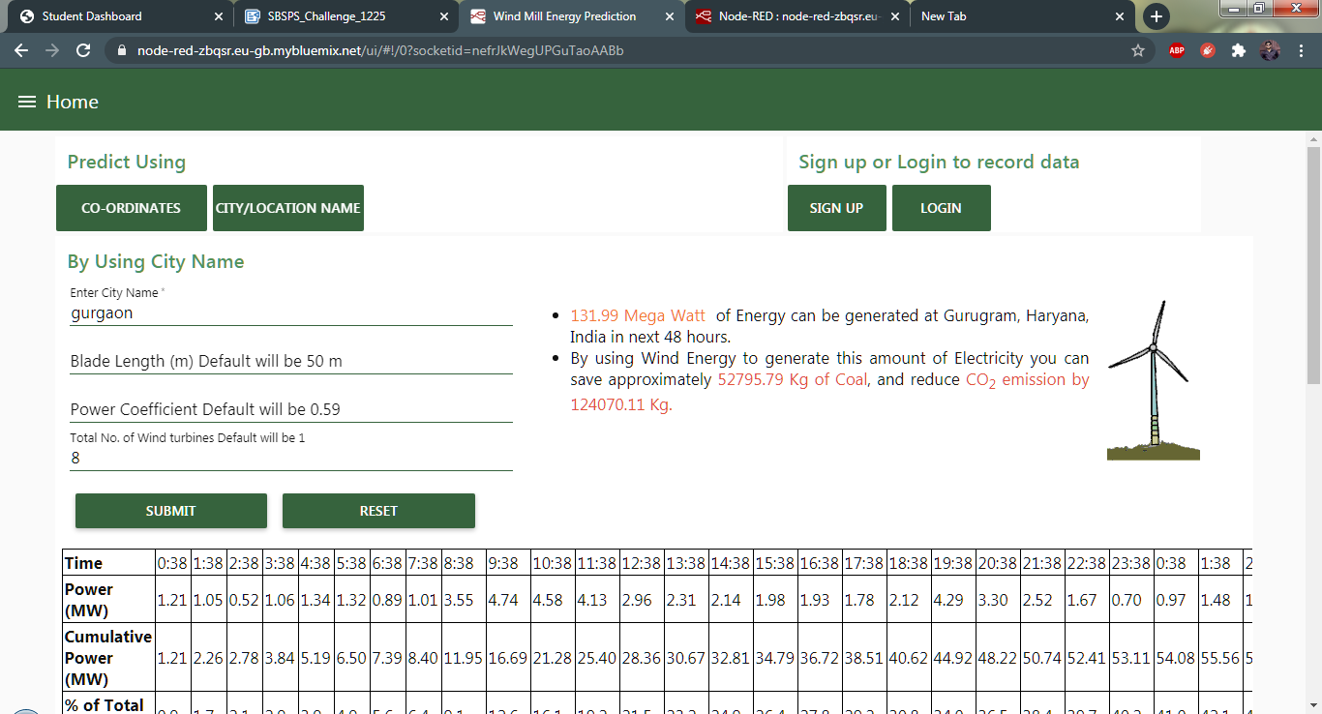
Result
1. Prediction by using City name-

Slide 12
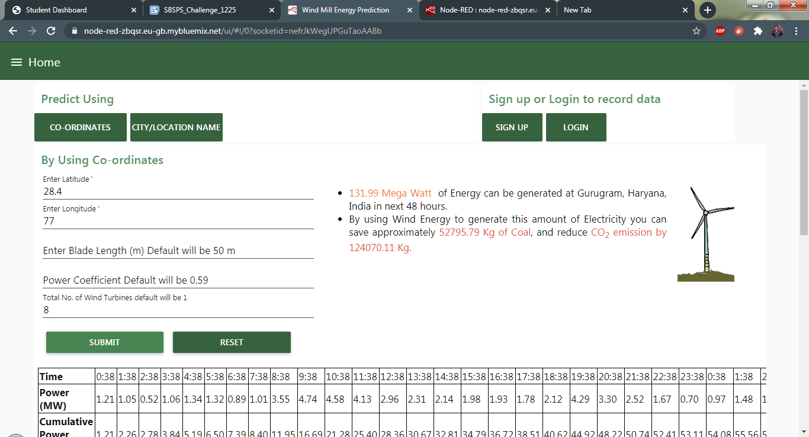
Result
2. Prediction using Coordinates-

Slide 13
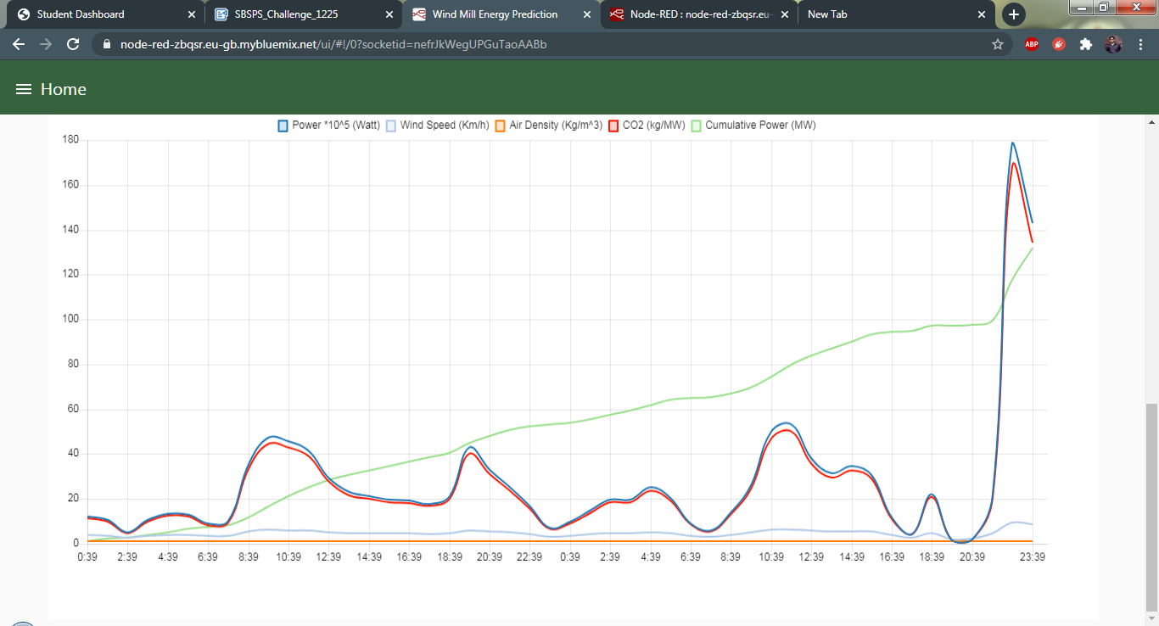
Result
3. Graph is also shown, which displays the data on hourly basis, for next 48 hours. It contain- Power, Wind Speed, Air Density, CO2 emission and cumulative power.

Slide 14
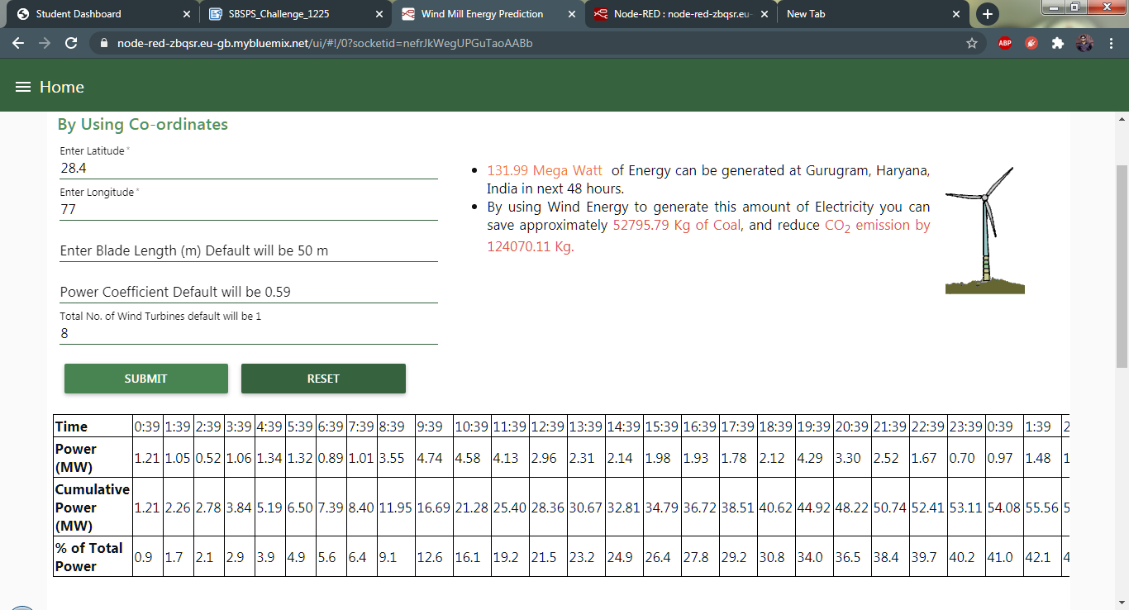
Result
4. Data is also shown in tabular form with respect to time, which contain power that can be developed after some particular hour, cumulative power upto that hour and percentage of power achieved of the total power upto that hour.

Slide 15
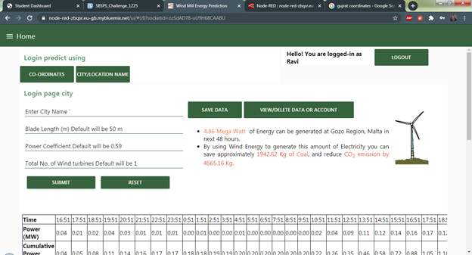
Result
If user wants to record this data for future use, then there is option to sign up and login. User must have to sign up first to record this data. after sign up user have to login to save, delete data or account. Logged in user UI-

Slide 16
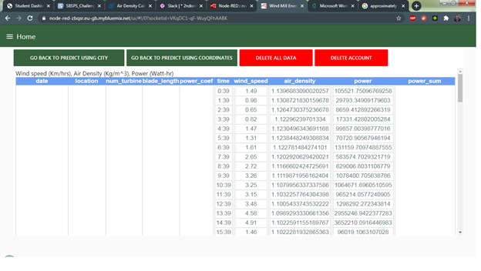
Result
5. Displaying of data and option to delete data or account.

Slide 17
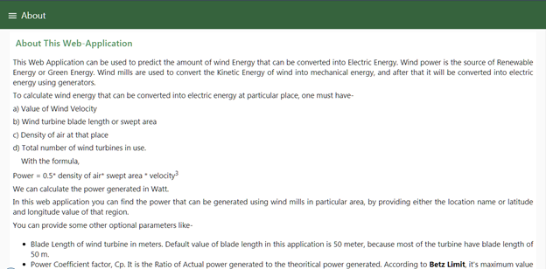
Result
6. There is also an About or help section, which describes the woking of web application, various concepts used to calculate the wind power.

Slide 18
ADVANTAGES & DISADVANTAGES
ADVANTAGES
This application uses weather data collected from OpenWeather API which provides most accurate weather data, and also uses machine learning for prediction.
In This app, I have calculated power, air density, pressure for every hour and then added the total to get maximum power that can be generated.
This hourly based model is more accurate than the average value model which uses same value of weather data for whole day.
So, This model will predict more accurate results.
This app also provide graph for easy analysis of the power generation for next 48 hours.
This app also gives value of CO2 emission if conventional steam power plant is used to generate the same amount of energy, by burning coal.
By analyzing that value it is easy to decide at what time, wind mills can be used effeciently.
DISADVANTAGES
The main disadvange18 of the app is, currently it can predict the value upto next 48-hours only.
It will be more helpful if we can predict the accurate value upto next 1 month.

Slide 19
APPLICATIONS
This web application can successfully predict accurate value of Electricity that can be generated using wind power at some location. However it can be used as following ways-
You don't have any wind mills at your chosen location, but you want to know how much energy you can get by installing wind mills at your chosen location.
You already have wind mills installed and you want to know how much energy you can generate in next 48 hours.
It can also be used to compare, how efficient is wind energy, and by how much you can prevent green house gases emission into the environment if wind power is used.
You want to know how much power you can generate at some location, along with that you also want to save weather and power data, for future use. For this you have to create account. This option is also provided in this app.

Slide 20
References
https://www.researchgate.net/publication/222383590_Carbon_dioxide_emissions_from_coal_based_power_generation_in_India
https://www.raeng.org.uk/publications/other/23-wind-turbine
https://www.omnicalculator.com/physics/air-density
https://en.wikipedia.org/wiki/Energy_policy_of_India

Slide 21
THANKYOU

